Slide 1
Hinton’s capsules

Slide 2
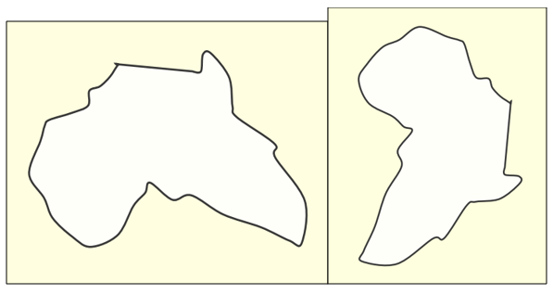
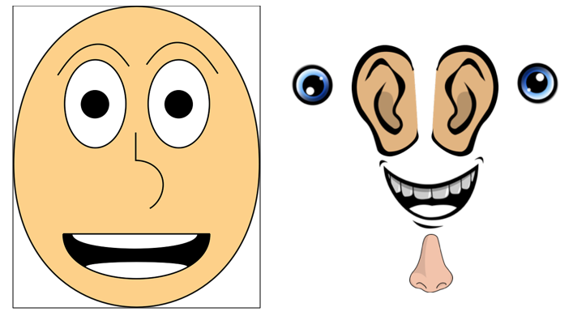
Problems with CNNs
They do not encode the position and orientation of the object into their predictions
AlexNet, which was the first major CNN and which won the ImageNet competition in 2012, solved this problem by training the CNN on augmented images. That is, they took an image and created many versions of it by tilting it, inverting it, rotating it and so on
Make predictions by checking if certain components are presents in the image or not, ignoring how they relate to each other
All lower level details are sent to higher level neurons
Hintons argues it would be better to route the image to specific neurons that have the capability to deal with those features
A face would have capsules route info about the pose and probability of ears, nose, etc to a higher level face capsule which would be able to compare “closeness” of features

Slide 3
Computer Graphics and the brain
Computer graphics have hard coded a solution to this spatial relation problem:
Objects are represented as arrays of geometrical objects & matrices in memory
This is then rendered to the screen using special software
Hinton argues brains do the opposite of rendering:
From visual info they deconstruct a hierarchical representation of the world and try to match it with already learned patterns

Slide 4
Overview of a capsule
Output:
Probability of detection of a feature is the length of the output vector
Orientation (pose) of detected feature is the direction of vector
This leads to activities equivariance
Neuronal activities will change when an object moves, but the probabilities of detection stay constant

Slide 5
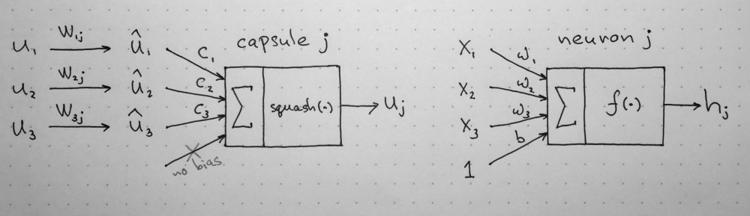
Neuron VS Capsule
Input/Ouput
Neuron: scalar
Capsule: vector
Operation
Neuron: summation of weighted input scalars and then activation fxn
Capsule: matrix multiplication of input vectors, scalar weighting of vectors, sum of weighted vectors, activation fxn

Slide 6
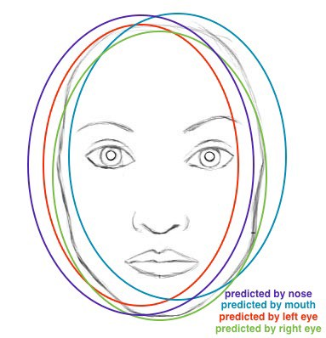
Matrix multiplication of input vectors
Receives vector(s) as input from previous capsule(s)
Vectors are multiplied by weight matrices that encode the relationship between lower and higher level features
ex/ a certain weight matrix might encode relationship between nose and face; face is centered around nose, is 10X the size of nose and its orientation in space corresponds to the nose
These weight matrices are learned by backprop and their shape is a design choice
After multiplying these weight matrices the result is a new vector that is the predicted position of the higher level feature based on only that input

Slide 7
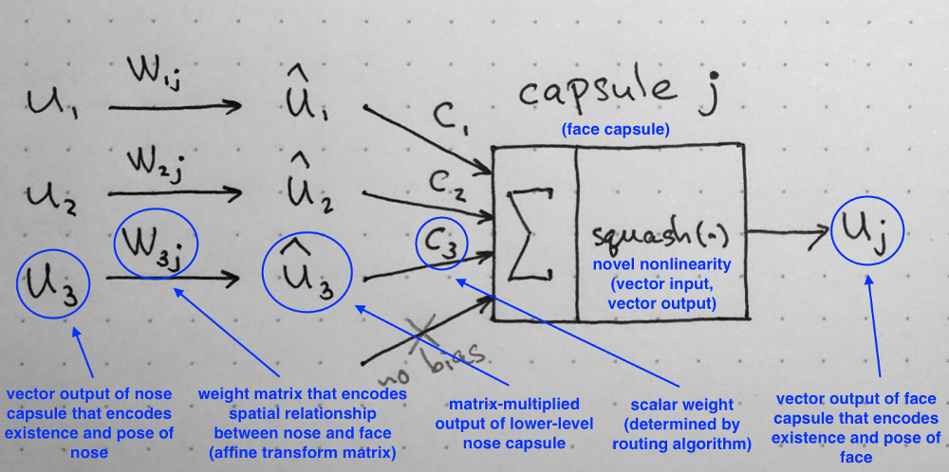
Scalar weighting of input vectors
The next step is taking these matrix multiplied outputs of lower level capsules and weighting them by a scalar
This is done according to the dynamic routing algorithm

Slide 8
Why Dynamic Routing
After the input vectors have been weighted, according to back-propogated matrix values that correspond to how the lower level features inform the higher, the dynamic routing algorithm must be carried out
This algorithm chooses a second set of weight values (this time scalars, not matrices) to weight how much each input vector (ex/ eyes, mouth, nose) should contribute to the next higher level output vector (ex/ face)
Why?
Each lower level layer needs to decide how to send its output vector to higher level capsules and so the weights essentially define a probability that its output is relevant, or “belongs to,” the higher level capsule

Slide 9
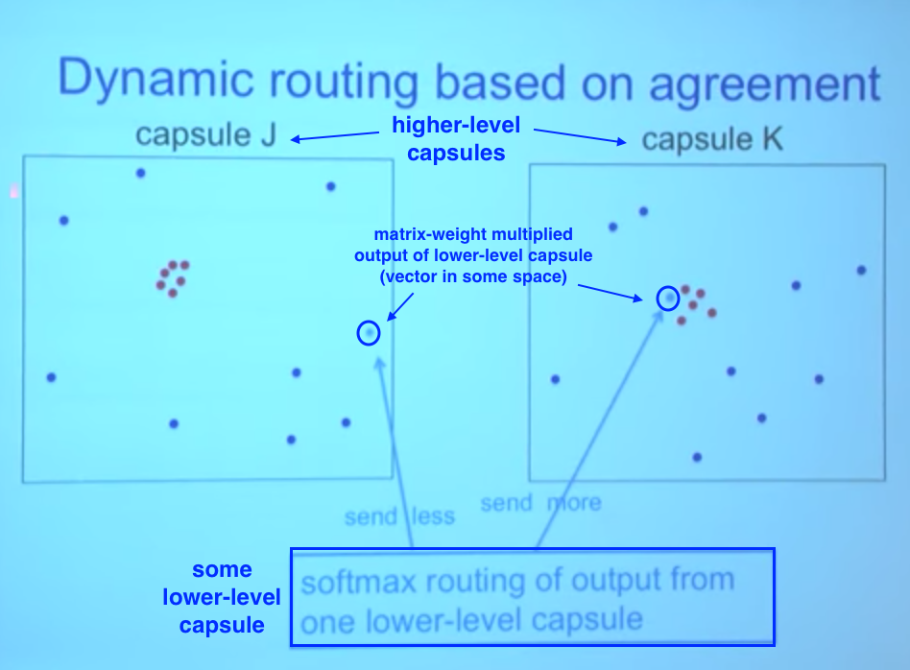
How Dynamic Routing
To decide which capsule(s) a lower level capsules output is relevant to it must “see into the future”
The algorithm does this by making the weight value correspond to capsules whose current outputs are similar to the input it is giving
Here it would send it to capsule K obviously
Intuition: A capsule will send its output to the higher level capsule that “Agrees” with its input
This makes sense because clearly a nose capsule would rather send its output to a Face rather than Arm capsule

Slide 10
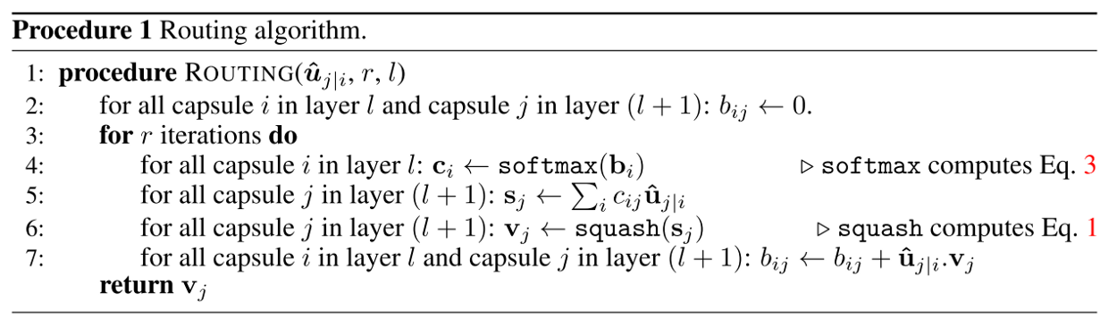
It iterates routing iteration ( r ) times through producing the output of a higher level capsule (capsule j, layer L+1) from outputs of each capsule in the lower level (capsule i, layer L) through:
Lines 4-6 calculates the output of higher level capsules based on the starting value of b_ij (starts at 0)
Line 4 calculates value of c_i which is all routing weights for lower level capsule i (softmax ensures each weight c_ij is non-negative and sum to 1 enforcing probabilistic nature)
During first iteration the value for all coefficient c_ij will be equal because all b_ij are 0
In this state L level capsules do not know which L+1 capsules best for their output
Line 5 adds input vectors weighted by routing coefficients c_ij producing vector s_j
Line 6 passes s_j through squash linearity which preserves direction but forces length <= 1

Slide 11
Lines 4-6 essentially calculate a hypothetical output of higher level capsules based on how the inputs are currently weighed
Line 7 looks at each higher level capsule’s input and updates the weight b_ij according to the formula
The formula says the new weight value equals the old value (b_ij) plus the dot product of the current output of the higher level capsule j (v_j) and input from the lower level i (u_ij)
Because of the properties of the dot product this will raise the weight value more if the two vectors (from i and j) are pointing in more similar directions and decrease if in dissimilar direction

Slide 12
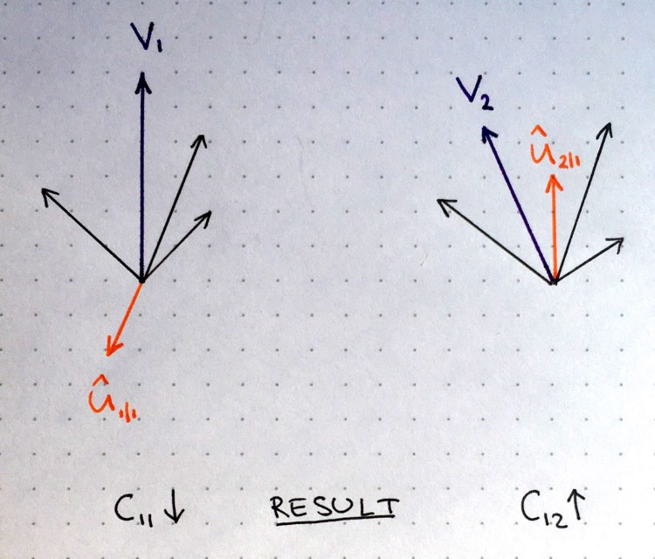
Two higher level vectors whose output is represented by purple vectors v1 and v2
Output calculated by steps 4-6 in previous slide
The orange vector represents input from one of the lower level capsules and the black represent all the other inputs from lower-level capsules
On the left side, because the dot product of V_1 and u_11 would be negative, the routing coefficient c_11 would decrease
On the right side the opposite would be truw
This procedure is repeated for all higher level capsules and for all outputs of each capsule
This results in a set of routing coefficients that best matches outputs from lower level to higher level
Now the network moves on to training the next layer
Side note: The recommended # of routing iterations is, surprisingly to me, only 3. More iterations tended to overfit the data according to the paper

